Slide 1

COVID HELPER - CoBot
For all our needs.

Slide 2
TEAM NAME: TESSERACT
TEAM MEMBER 1: CHINTALA SANTOSHI REDDY
1
TEAM MEMBER 2: PAMIREDDY MEGHANA
2
TEAM MEMBER 3: AMINA AFSA
3

Slide 3
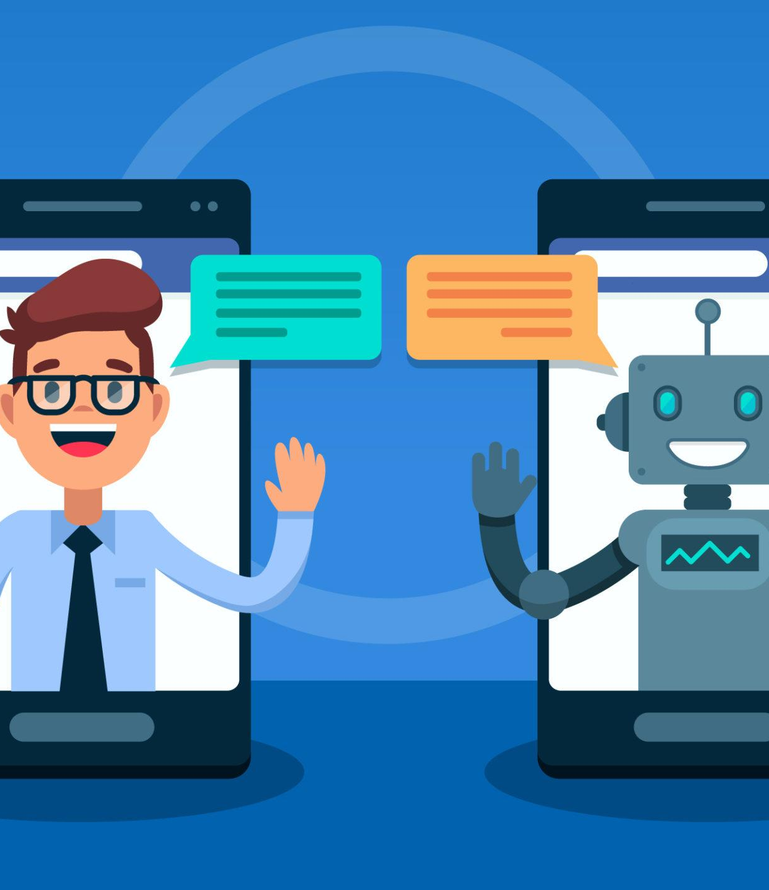
Chatbot
A chatbot is an artificial intelligence (AI) software that can simulate a conversation (or a chat) with a user in natural language through messaging applications, websites, mobile apps or through the telephone. A chatbot is often described as one of the most advanced and promising expressions of interaction between humans and machines. However, from a technological point of view, a chatbot only represents the natural evolution of a Question Answering system leveraging Natural Language Processing (NLP). Formulating responses to questions in natural language is one of the most typical examples of Natural Language Processing applied in various enterprises’ end-use applications.
This Photo by Unknown Author is licensed under CC BY-SA

Slide 4
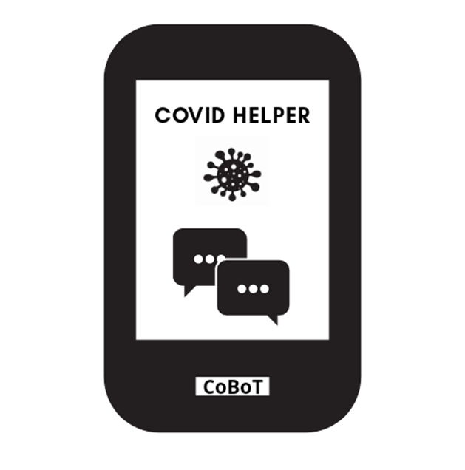
COVID HELPER - CoBot
Covid Helper - CoBot, for all our needs. This chatbot is all about coronavirus. It gives the detailed information about what coronavirus is; how it is originated; symptoms & prevention. We also added some important links/images which makes us understand better, about latest updates about COVID-19 vaccines; cases being registered world wide; how to disinfect your food/surroundings/objects around you; how to boost your immunity; stress management. Most importantly alternative career options and books/courses for free.

Slide 5
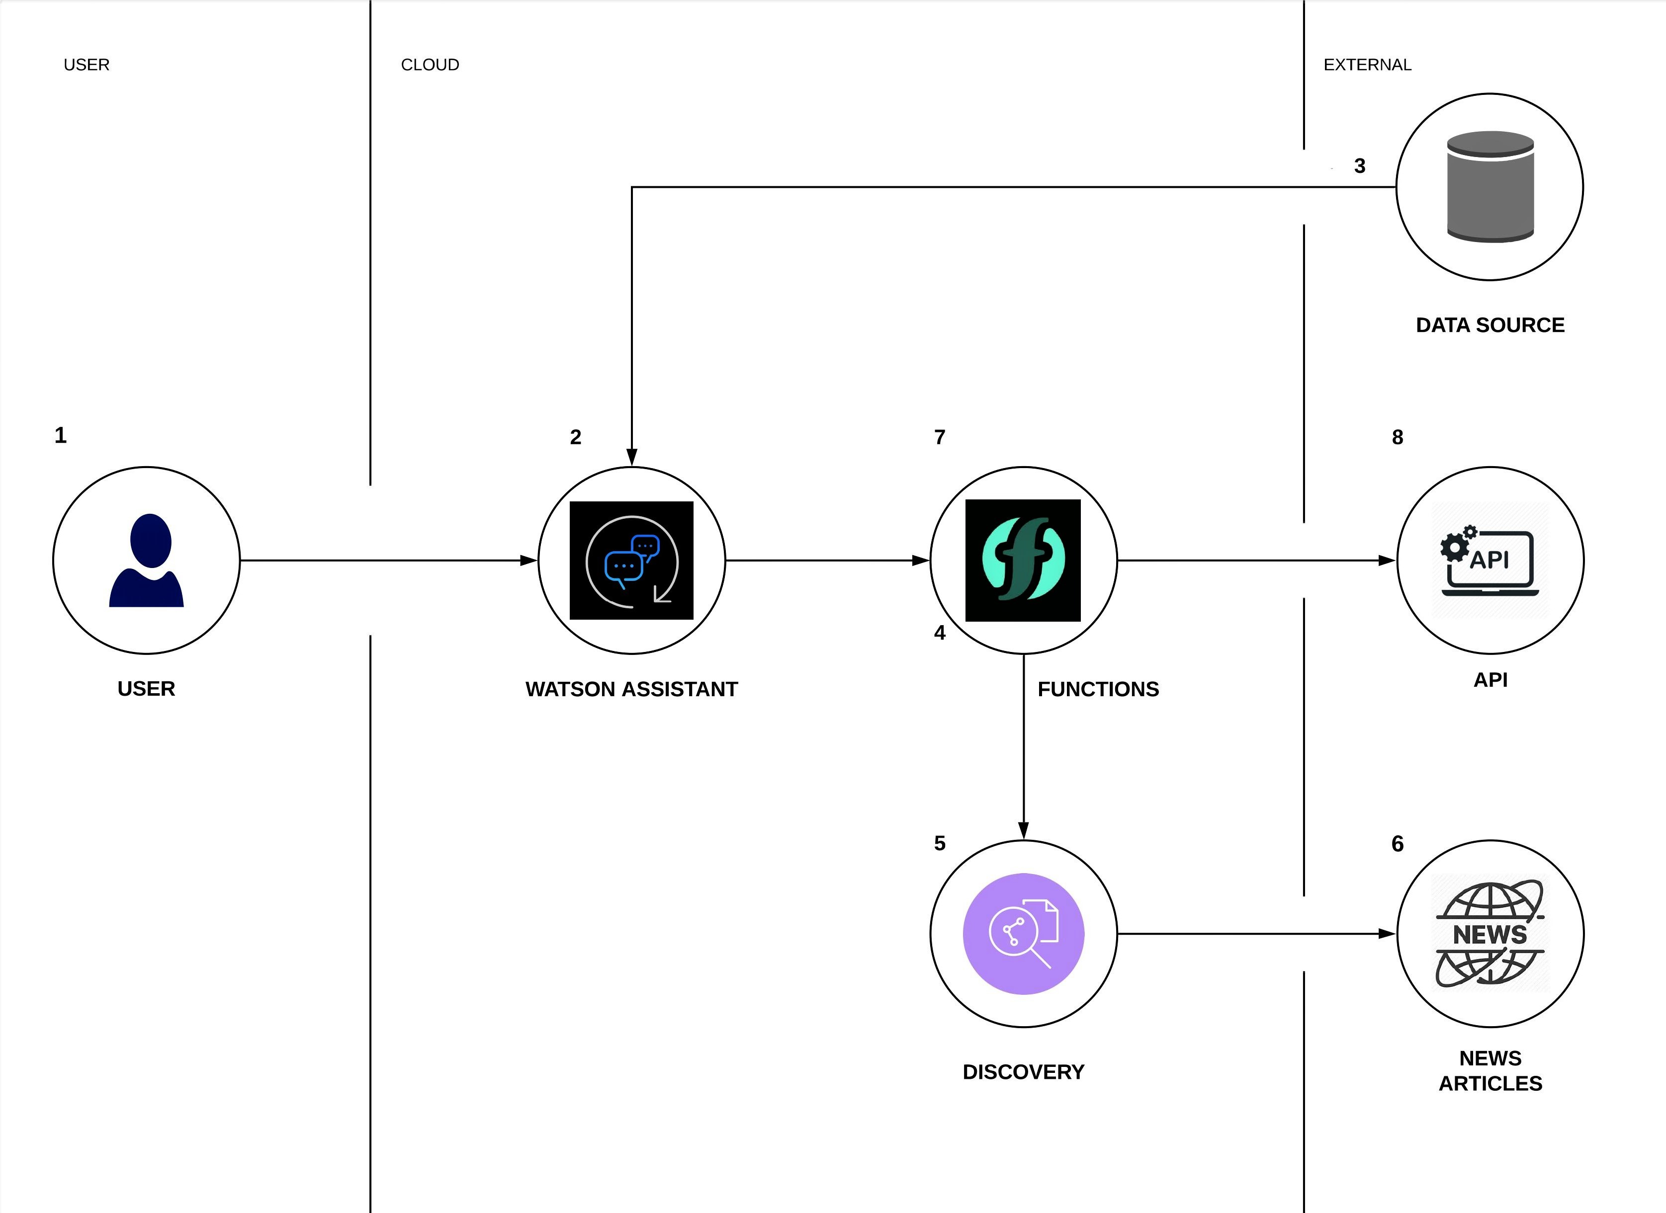
ARCHITECTURAL OVERVIEW

Slide 6
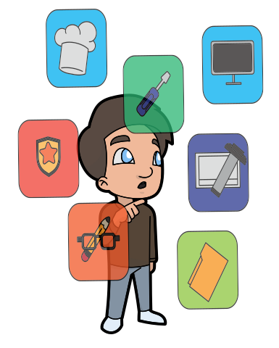
Future Scope
Different career options during this pandemic.
As the world faces unprecedented challenges and workplaces experience increasing pressure, now more than ever taking charge of your career is essential. The main solution of this Covid Helper- CoBot is to showcase different career options during this pandemic and find free books/courses for students. Alternative career options we mentioned are:
1)Blogging
2)Online training and education
3)Volunteering
4)Farming at home

